Slide 1
Money Transfer System
Yuvaraj K

Slide 2
Current Features
Security and Reliability
Backend and Business Logic
Frontend and Design
JWT Authentication and Stateless Security
Centralized Deposit System
Component-Driven UI Architecture
Idempotency Engine
Rollback Protocol
Responsive & Dynamic Design System
UI and Endpoints Secured via RBAC
Robust Constraints and Validation
Reactive State & Event Handling

Slide 3
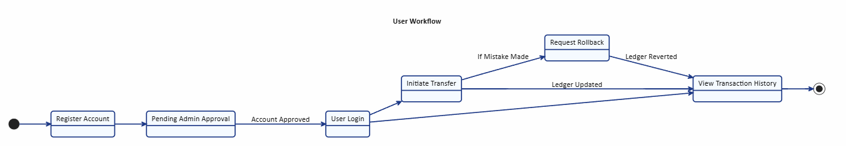
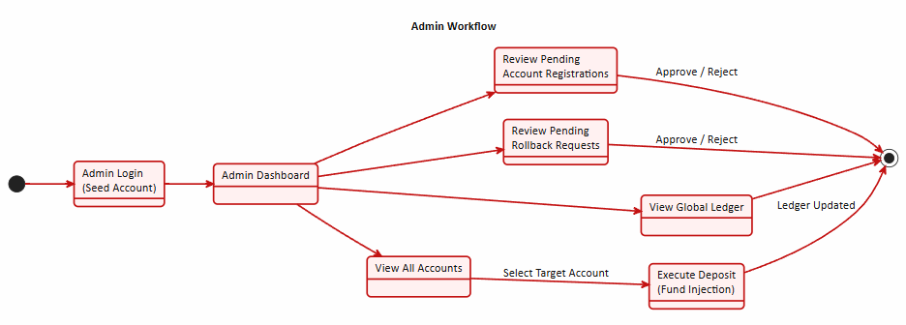
High-Level Workflow

Slide 4
Design Patterns
d
Creational
Singleton | Controllers, Services, Repositories
Dependency Injection | Dependencies injected into constructors at runtime
Structural
Proxy | Dynamic proxies for AOP
Facade | Controllers serve as facades
Behavioral
Observer | Observable, Subject, EventEmitter for reactive UI
Strategy | BCrypt Password Encoder
Factory | WebApplicationContext --> lifecycle management
Builder | Complex objects built and forwarded cleanly
Decorator | @Transactional, @PreAuthorize act at runtime
Composite | Hierarchical composite tree of standalone components
Adapter | CustomDatePipe
Chain of Responsibility | Security Filter Chain processes requests sequentially
Iterator | Java streams in backend, @for in Angular
Template Method | Custom logic in template methods like ngOnInit
d
d

Slide 5
Linked Accounts and Self-Transfer
Unique Identity for Each User
Single User with Multiple Account Tyes
Auto-Linking during Admin Approval
Singular Dashboard to Access All Account Types
Contextual Self-Transfer UI for users with multiple accounts
New Self-Transfer Transaction Type
Accounts Linked by Group ID (UUID v4)

Slide 6
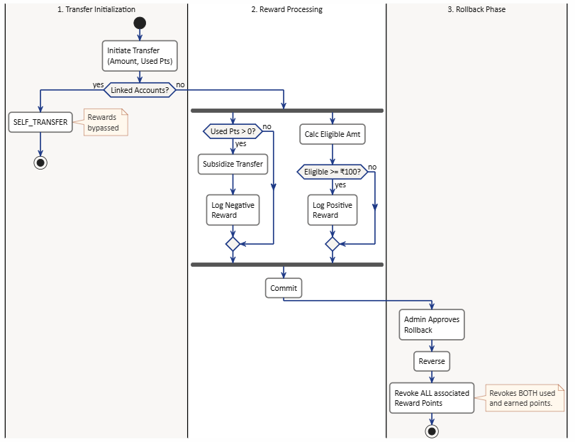
Reward System
Applicable to non-self transfer. Transfers to linked accounts not considered
Reward R = Floor(Amount A/100)
A = 100, R = 1; A = 299, R = 2
If transaction rollback approved, then no rewards
Rewards are used in non-self transfers. Amount equal to reward points applied is reduced
If 100 is sent with 10 reward points applied, 90 is deducted from the wallet. Receiver still gets 100
Rewards can be simultaneously used and gained during transfers
If rewards are used, rewards gained is computed with Amount = Total Amount transferred – Rewards Used

Slide 7
Demo
Money Transfer System

